Slide 1
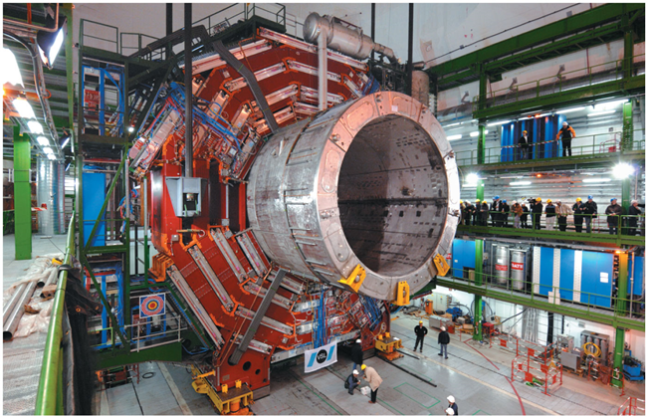


SOURCES OF MAGNETIC FIELD

Slide 2
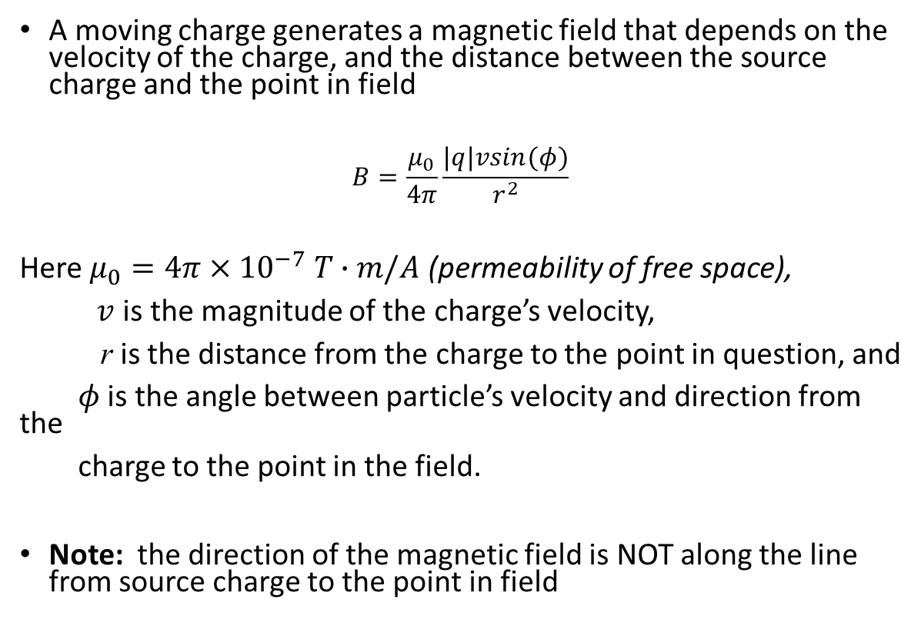
Magnetic field of a moving charge, magnitude
A moving charge generates a magnetic field that depends on the velocity of the charge, and the distance between the source charge and the point in field
$$B=\frac{μ_{0}}{4π}\frac{|q|vsin(φ)}{r^{2}}$$
Here $μ_{0}=4π×{10}^{−7} T∙m/A$ (permeability of free space),
$v$ is the magnitude of the charge’s velocity,
r is the distance from the charge to the point in question, and
$φ$ is the angle between particle’s velocity and direction from the
charge to the point in the field.
Note: the direction of the magnetic field is NOT along the line from source charge to the point in field

Slide 3
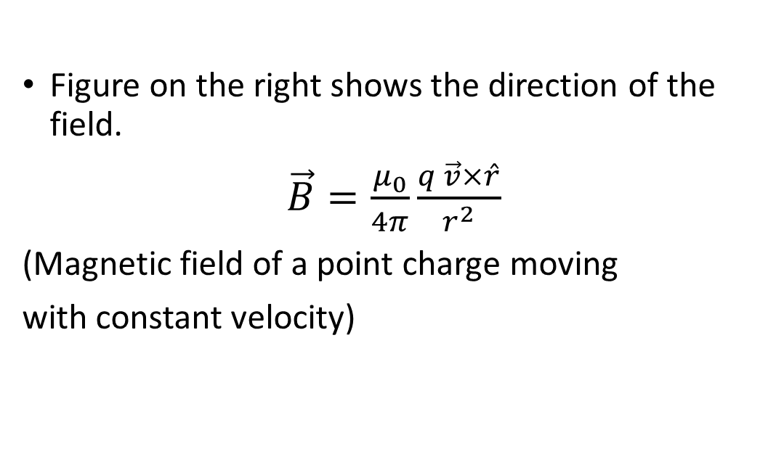
Magnetic field of a moving charge, direction
Figure on the right shows the direction of the field.
$\vec{B}=\frac{μ_{0}}{4π}\frac{q \vec{v}×\hat{r}}{r^{2}}$
(Magnetic field of a point charge moving
with constant velocity)

Slide 4
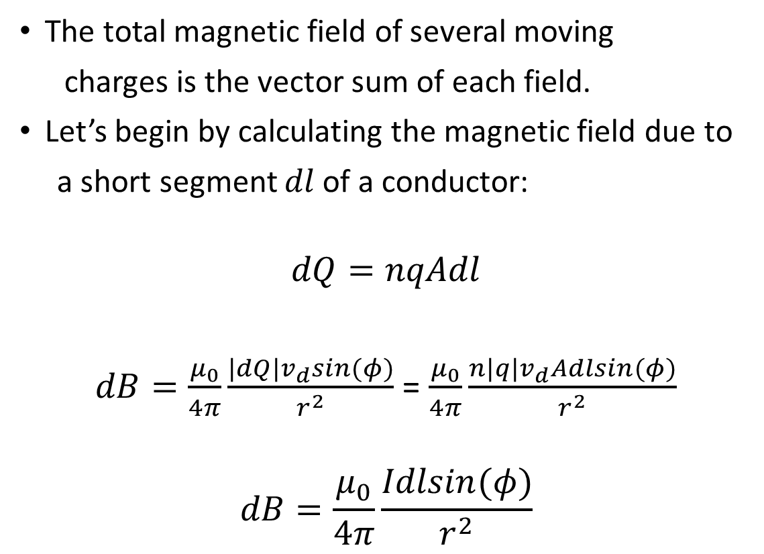
Magnetic field of a current element
The total magnetic field of several moving
charges is the vector sum of each field.
Let’s begin by calculating the magnetic field due to
a short segment $dl$ of a conductor:
$$dQ=nqAdl$$
$dB=\frac{μ_{0}}{4π}\frac{|dQ|v_{d}sin(φ)}{r^{2}}$ = $\frac{μ_{0}}{4π}\frac{n|q|v_{d}Adlsin(φ)}{r^{2}}$
$$dB=\frac{μ_{0}}{4π}\frac{Idlsin(φ)}{r^{2}}$$

Slide 5
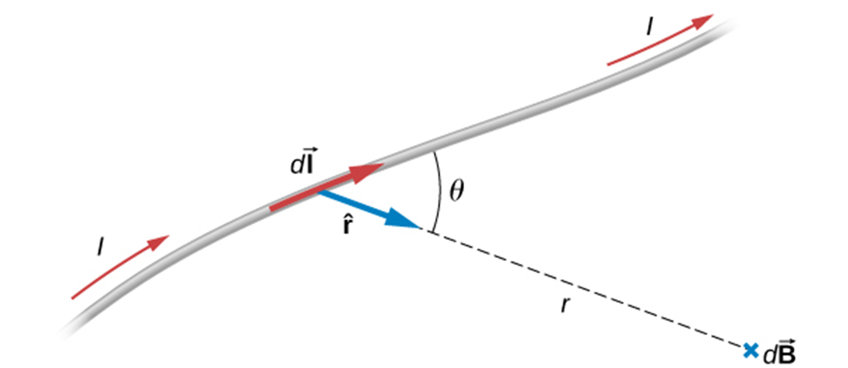
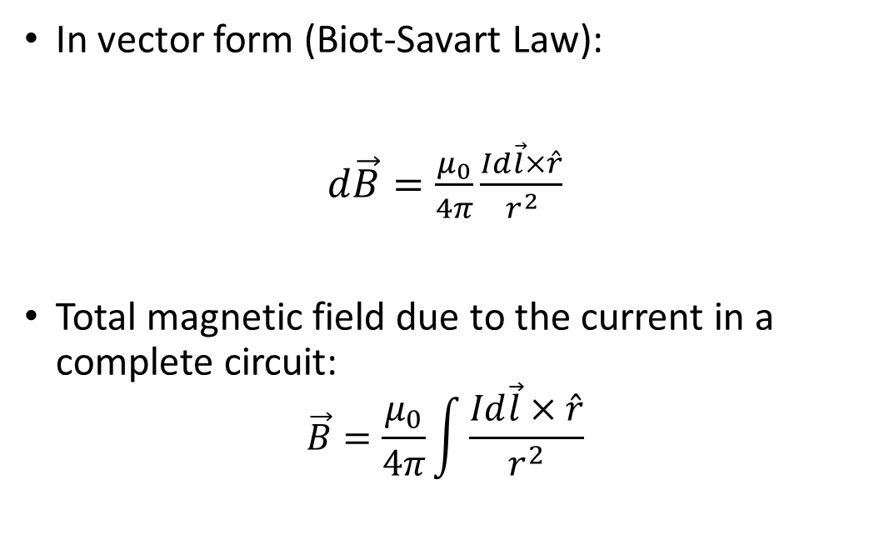
Magnetic field of a current element
In vector form (Biot-Savart Law):
$d\vec{B}=\frac{μ_{0}}{4π}\frac{Id\vec{l}×\hat{r}}{r^{2}}$
Total magnetic field due to the current in a complete circuit:
$$\vec{B}=\frac{μ_{0}}{4π}\int{\frac{Id\vec{l}×\hat{r}}{r^{2}}}$$

Slide 6
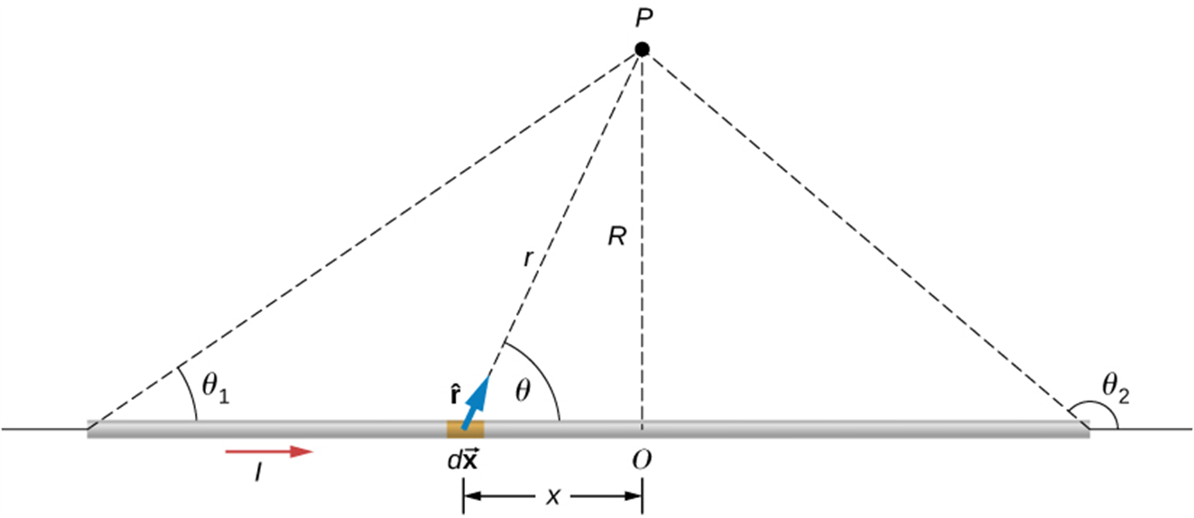
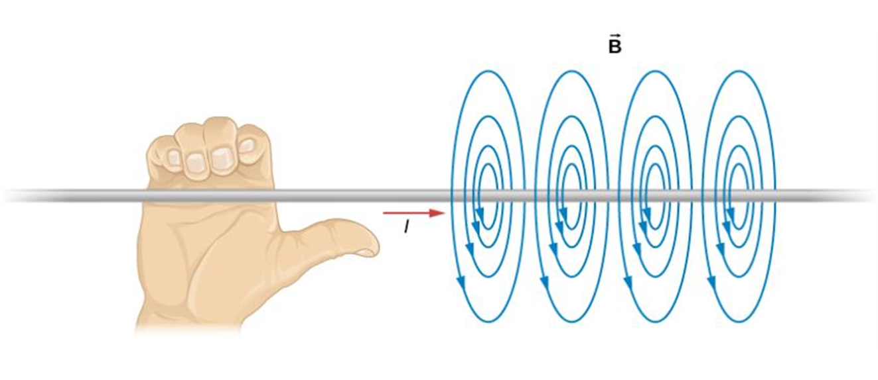
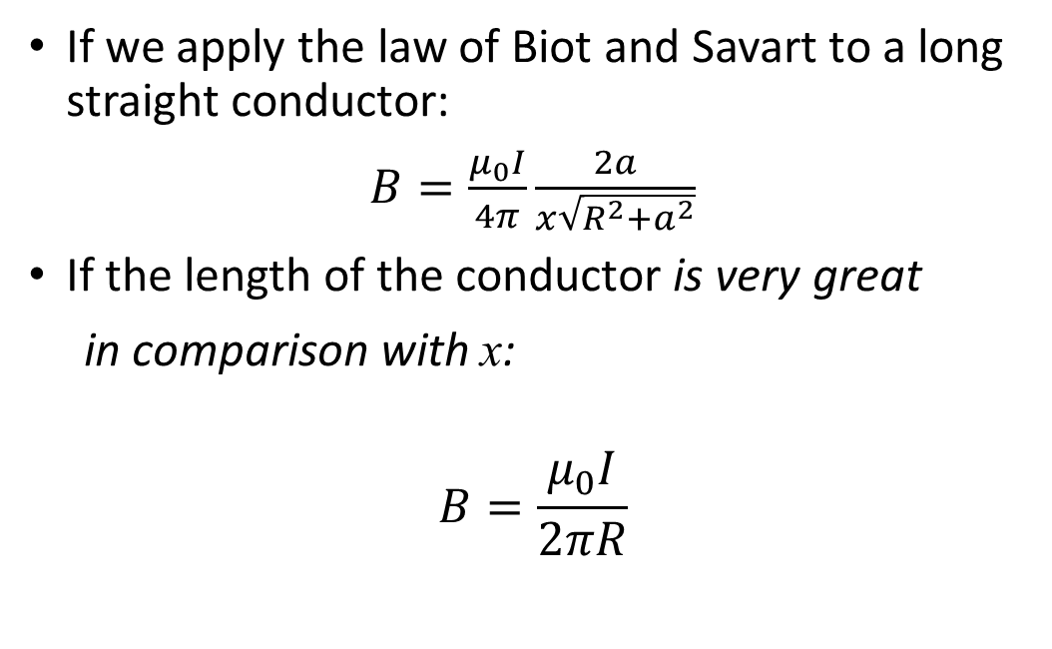
Magnetic field of a straight current-carrying conductor
If we apply the law of Biot and Savart to a long straight conductor:
$B=\frac{μ_{0}I}{4π}\frac{2a}{x\sqrt{R^{2}+a^{2}}}$
If the length of the conductor is very great
in comparison with x:
$$B=\frac{μ_{0}I}{2πR}$$

Slide 7
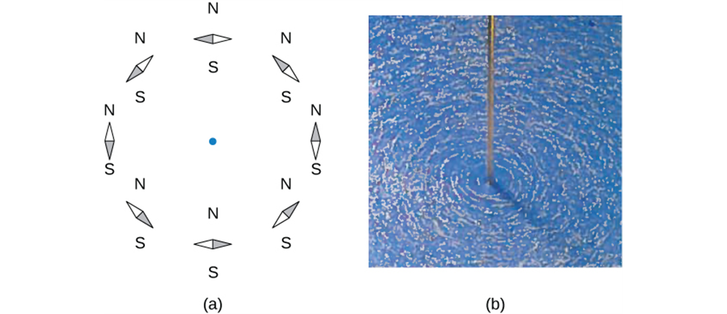
Magnetic field of a straight current-carrying conductor
The shape of the magnetic field lines of a long wire can be seen using (a) small compass needles and (b) iron filings.

Slide 8
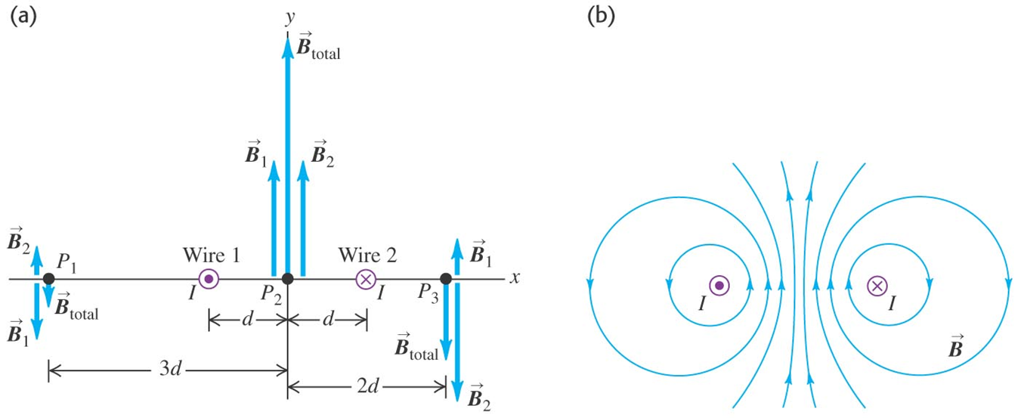
Magnetic field of two long wires, example

Slide 9
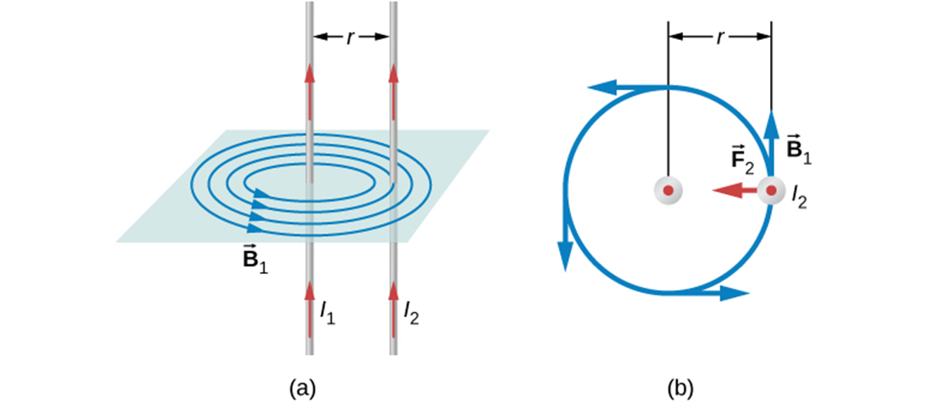
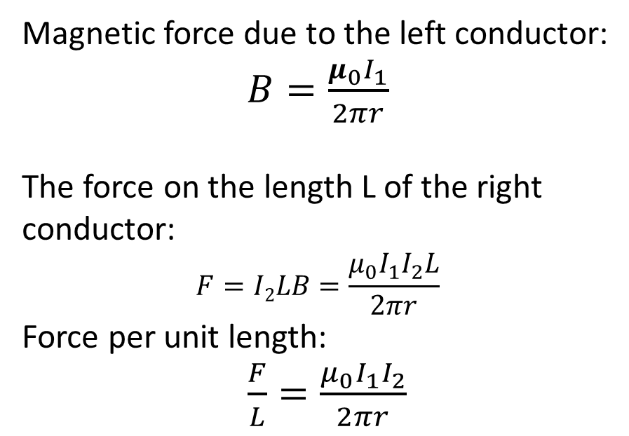
Forces between parallel conductors
Magnetic force due to the left conductor:
$B=\frac{μ_{0}I_{1}}{2πr}$
The force on the length L of the right conductor:
$$F=I2LB=\frac{μ_{0}I_{1}I_{2}L}{2πr}$$
Force per unit length:
$\frac{F}{L}=\frac{μ_{0}I_{1}I_{2}}{2πr}$
The conductors attract each other if the currents are in the same direction and repel if they are in opposite directions.

Slide 10
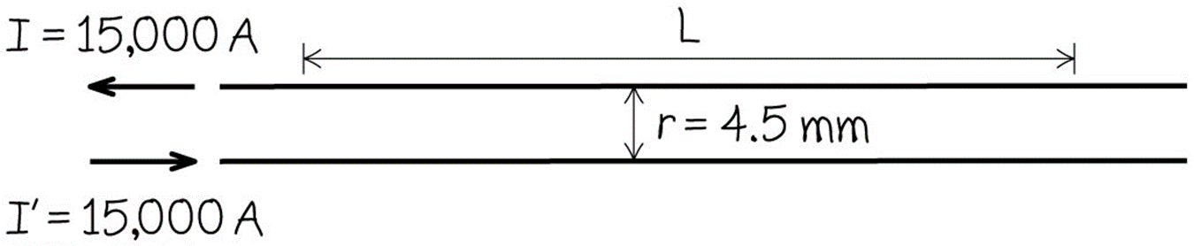
Forces between parallel wires, example
$\frac{F}{L}=\frac{μ_{0}II^{′}}{2πr}= \frac{(4π×{10}^{−7}T∙m/A)(15,000 A)(15,000 A)}{2π (4.5 × {10}^{−3}m)}=1.0 ×{10}^{4}N/m$
One ampere is that current that if present in each of two parallel conductors of infinite length and one meter apart in empty space, causes each conductor to experience a force of exactly 2 x 10⁻⁷ newtons per meter of length.

Slide 11
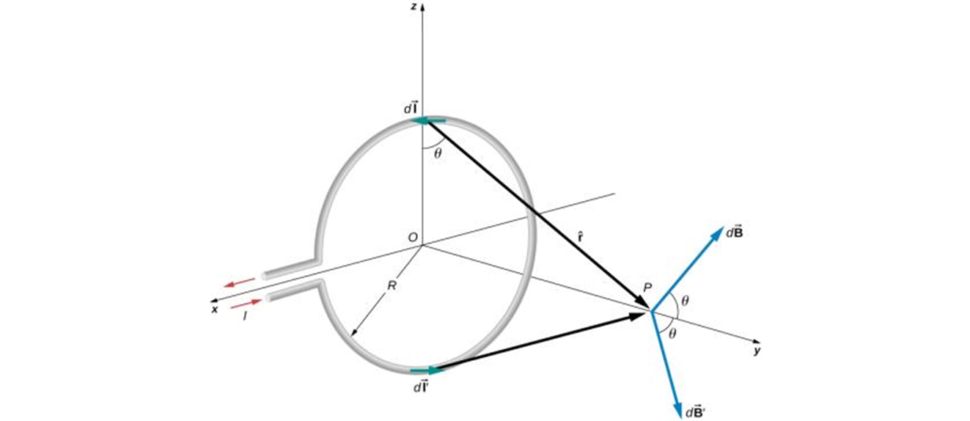
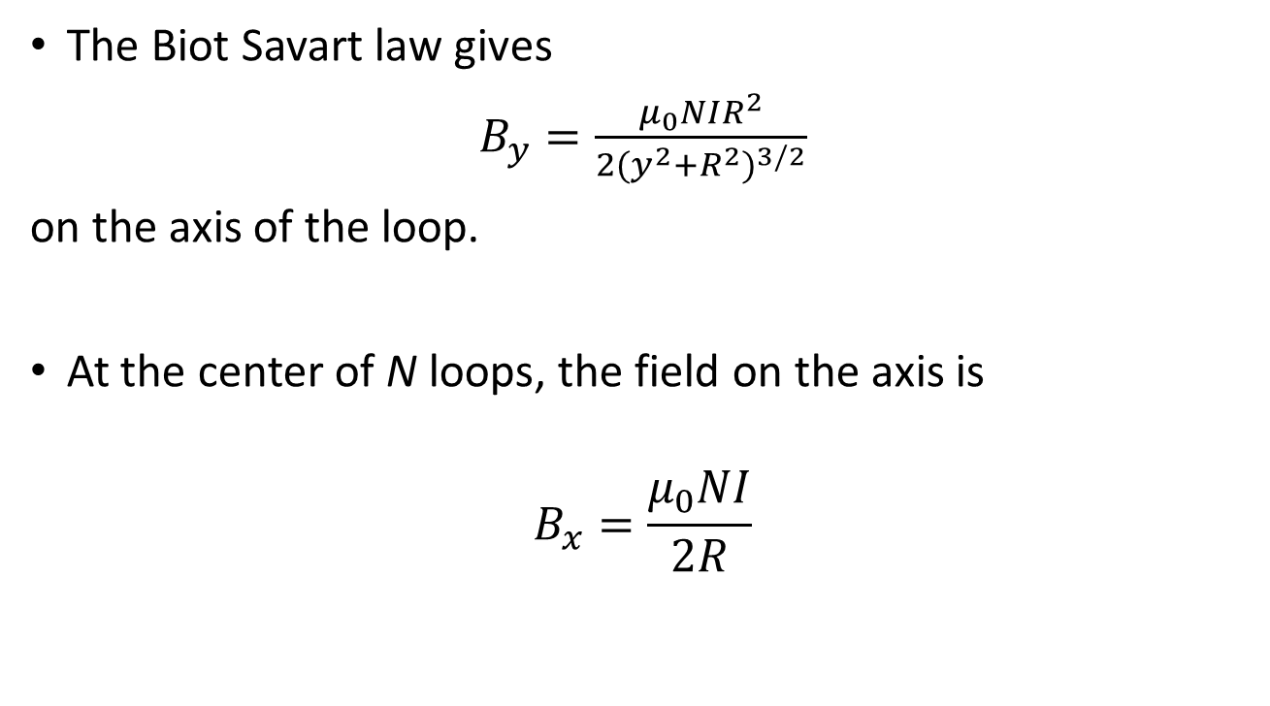
Magnetic field of a circular current loop
The Biot Savart law gives
$B_{y}=\frac{μ_{0}NIR^{2}}{2(y^{2}+R^{2})^{3/2}}$
on the axis of the loop.
At the center of N loops, the field on the axis is
$$B_{x}=\frac{μ_{0}NI}{2R}$$

Slide 12
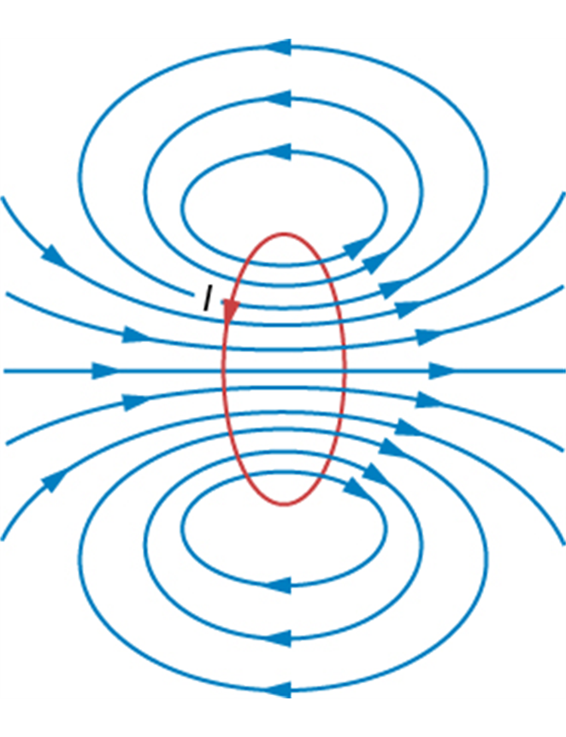
Magnetic field of a circular current loop II

Slide 13
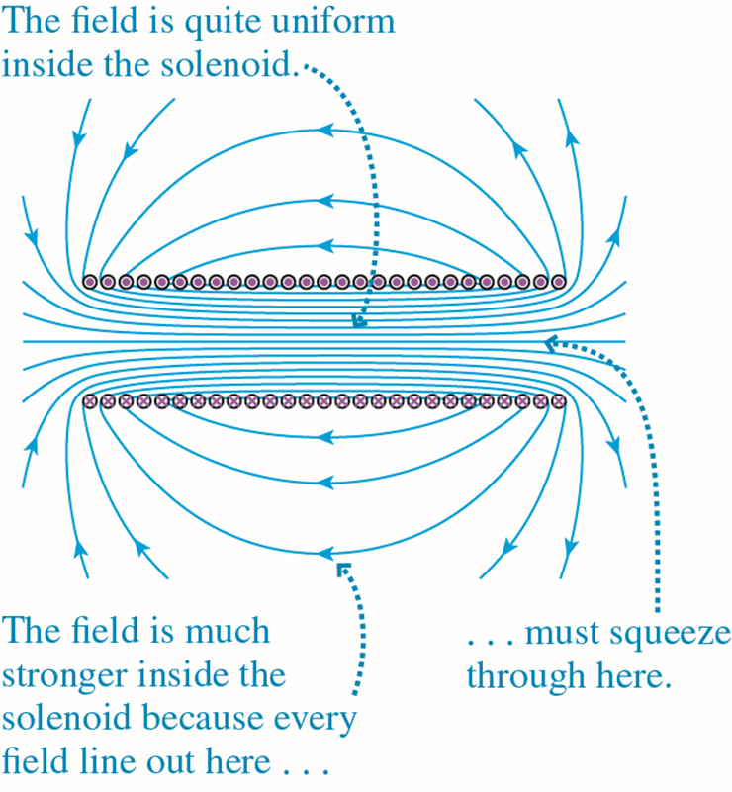
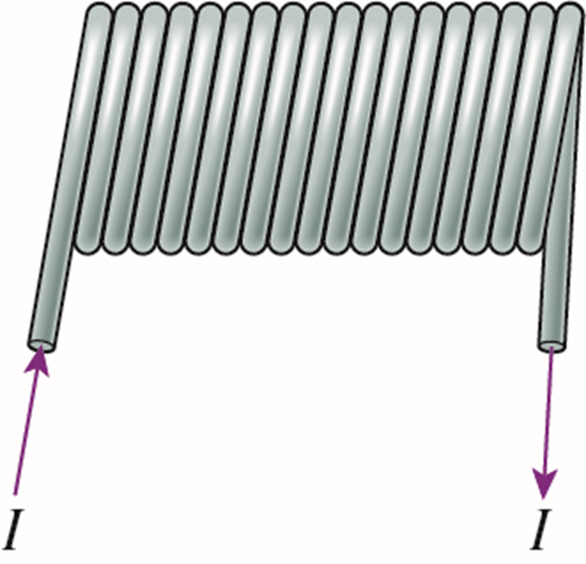
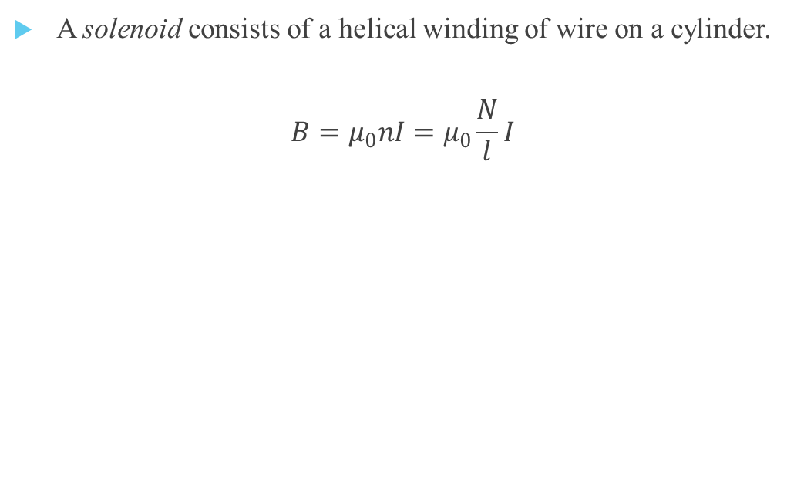
Magnetic field of a solenoid
A solenoid consists of a helical winding of wire on a cylinder.
$$B=μ_{0}nI=μ_{0}\frac{N}{l}I$$

